Slide 1
AIPLIRS Edited presentation
Jufrey Niño E. Bayog
John Paul S. Bobila
Systems Development
PIMD-ICT

Slide 2
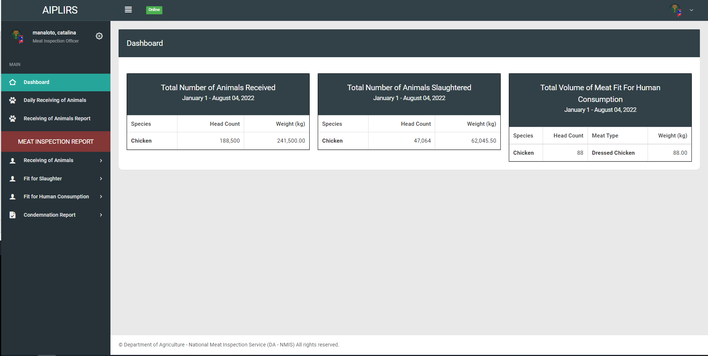
Remove Navigation bar header and breadcrumbs on all pages
Create a summary card for the receiving, fit for slaughter, fit for human consumption
To be added on MIO account sidebar:
Output is the summary on the all Meat establishment assignment base on dates
(suggestions: tick boxes for the Current, previous)

Slide 3
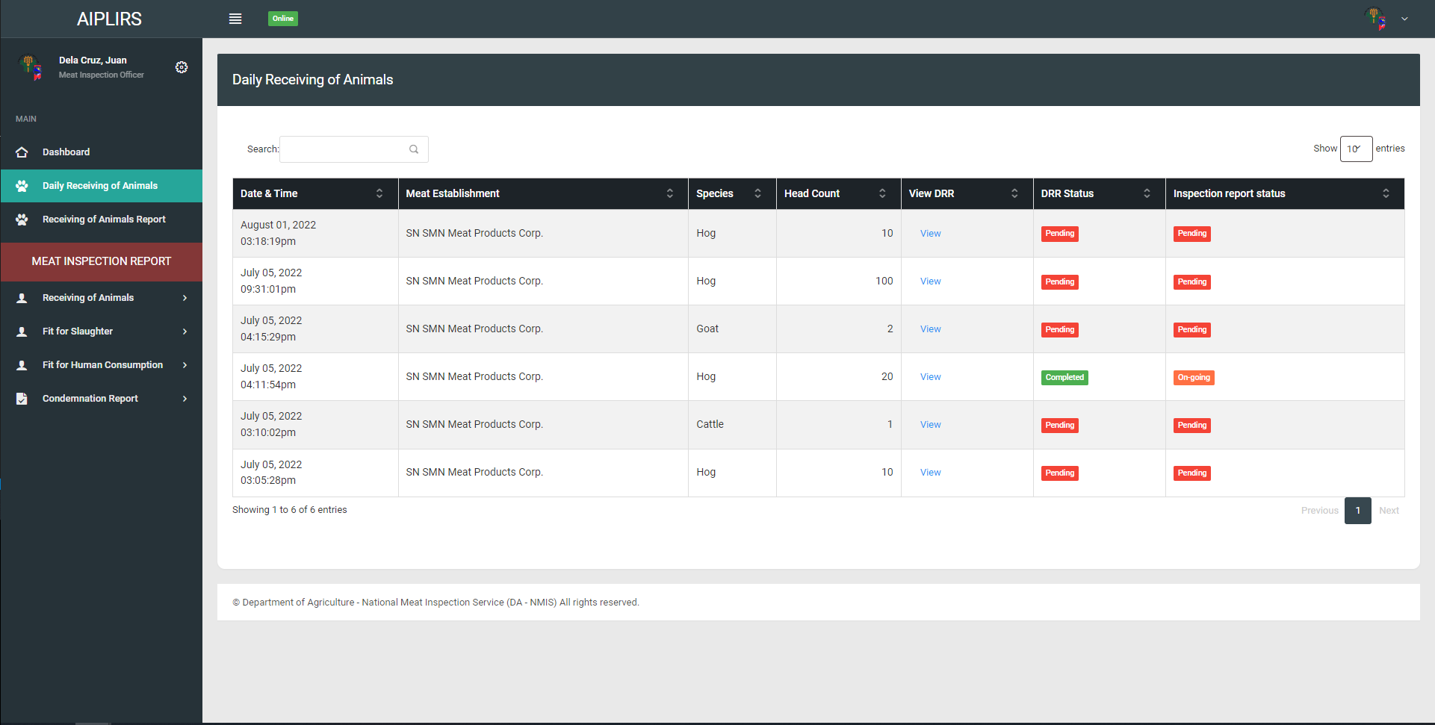
Change sidebar title to Daily Receiving of Animals
Change title to Daily Receiving of Animals
Change header title
Establishment to Meat establishment
Change address format to “barangay, city, province”

Slide 4
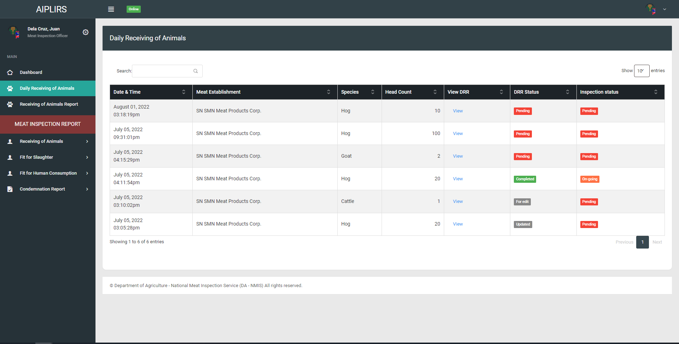
DRR status: pending (request to edit), Completed,
Details of DRR page action: proceed to inspection(DRR status will update to approved), request to edit
Inspection report status: Pending(upon checking Drr page), On-going(if DRR is approved color: orange), completed(Antemortem & postmortem conducted)
View Details to View DRR
Remove action column meat dealer, total weight, batch number, holding pen
Change positioning of after head count change header “drr details” button “td” view
Order of the table after drr details “DRR STATUS”, “INSPECTION STATUS”

Slide 5
PENDING REVISIONS

Slide 6
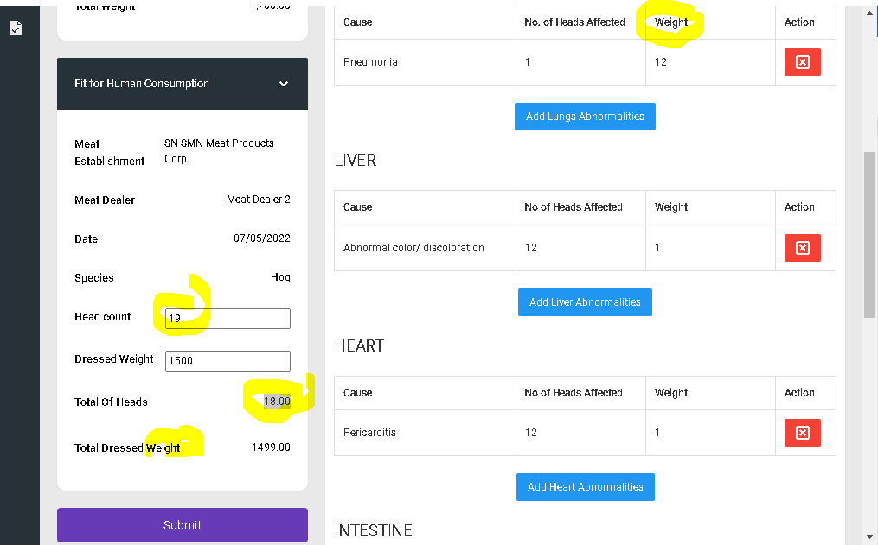
Acccept decoimal poimt for SLH only (.5)
Redo the codes that function the head count input based on fit for slaughter
Change the title to” total head count”
Sytem will be redirected to antemortem

Slide 7
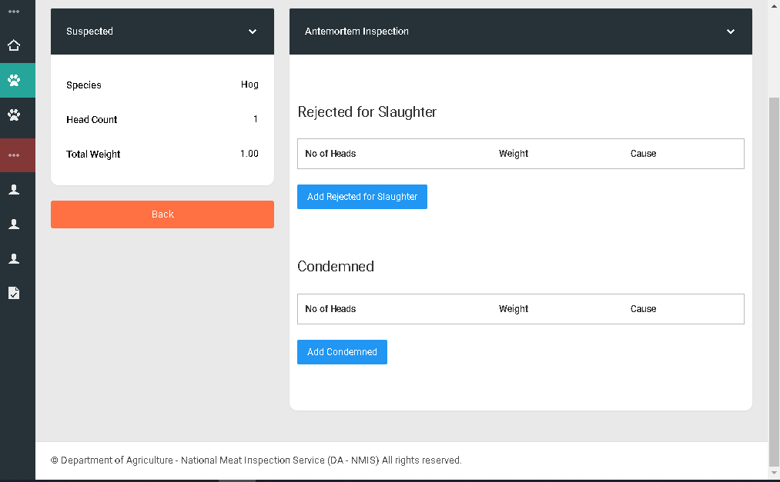
“Passed for slaughter” add a row
Suggestion:” confirmatory result
“Proceed to inspection button green” redirect to post-mortem inspection

